Slide 1
Three New Probabilistic Models for Dependency Parsing: An Exploration
Zhen Cheng

Slide 2
Outline
Model A: a lexical affinity model where words struggle to modify each other
Model B: a sense tagging model where words fluctuate randomly in their selectional preferences
Model C: a generative model where the speaker fleshes out each word’s syntactic and conceptual structure without regard to the implications for the hearer

Slide 3
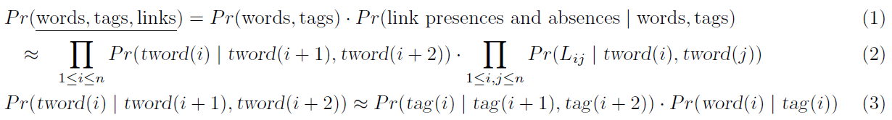
Model A: Bigram lexical affinities
Steps:
A sequence of tags is generated according to a Markov process, with the random choice of each tag conditioned on the previous two tags.
A word is chosen conditional on each tag.
Look at each pair of words and randomly decide whether to link them.

Slide 4
Model A: Bigram lexical affinities
Notice:
Actually lexically sensitive, depend on (word, tag) pairs.
Stipulate no crossing links or multi parents.
Generalization, like (3), avoiding the effects of undertraining.

Slide 5
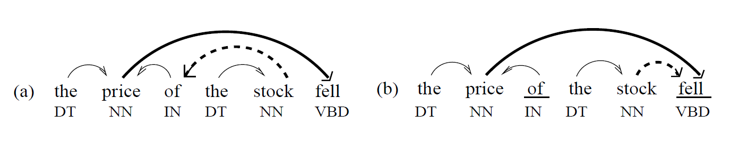
Model A: Bigram lexical affinities
Problems
Solutions
Lij on the number and/or type of children of i that already sit between i and j.
New Problems
fell prefers stock rather than price.

Slide 6
Model B: Selectional preferences
Compare to Model A:
Model A chooses the arcs for j from C(2,n) possible links, considers the benefit of selecting i and cost of spurning i’.
Model B simply has each word blindly describe its ideal parent & children.

Slide 7
Model B: Selectional preferences
Disjunct
a set of selection preferences for each word.
If the disjuncts are sufficiently specific, it specifies at most one parser.
However, they cannot be simultaneously satisfied usually.

Slide 8
Model C: Recursive generation
Compare to Model A & B:
Model A & B are comprehension model, suggesting the speakers’ text can be easily decoded by the listener.
Model C is generation model, saying the speakers flesh out the syntactic and conceptual structure for each word.

Slide 9
Model C: Recursive generation
Generation process: once add word i
Left children: a Markov sequence of (tag, word) pairs.
START->STOP
Right children: a separate sequence of (tag, word) pairs.

Slide 10
Model C: Recursive generation
kid(i, c): cth-closest right child of word i
kid(i, 0) = START
kid(i, 1 + #right-kids(i)) = STOP
(c < 0 indexes left children.)

Slide 11
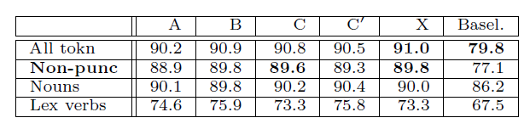
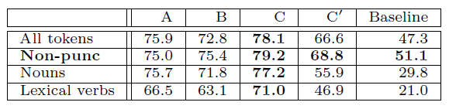
Comparision
Data set: a moderate corpus of 25,000+ tagged, dependency-annotated Wall Street Journal sentences
Tokens correctly tags:
Tokens correctly attached to their parents

Slide 12
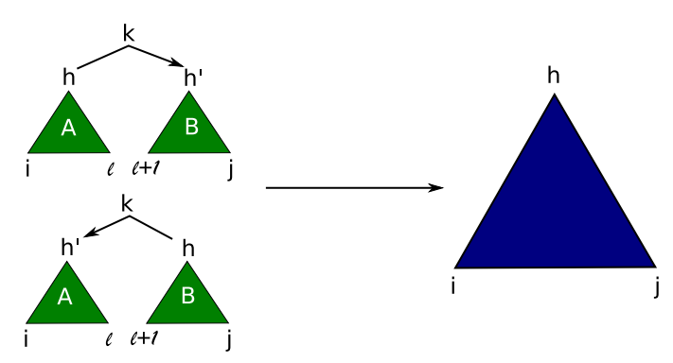
Eisner Dependency Parsing
A novel dynamic-programming method
Similar to the CKY method -- O(n^3s^2) time and O(n^2s) space
Old method: a constituent’s probabilistic behavior depends on its headword, then differently headed analyses need different signatures.

Slide 13
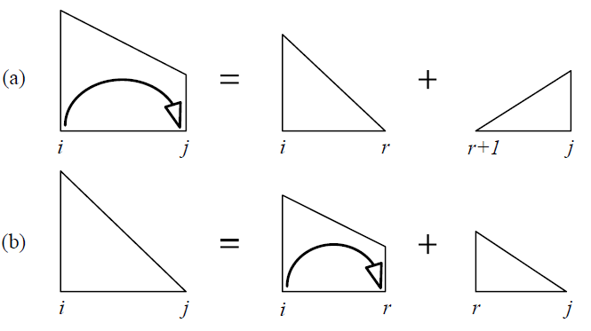
Eisner Dependency Parsing
The parser will analyze them as non-constituent spans that will be concatenated into larger spans
A span consists of 2 adjacent words
Tags for all these words except possibly the last
A list of all dependency links among the words in the span
Some other information carried along in the span’s signature

Slide 14
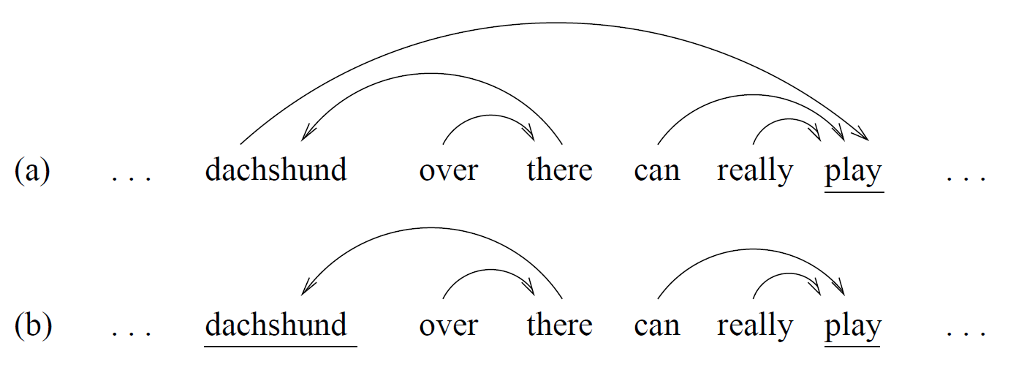
Eisner Dependency Parsing
Two kinds span

Slide 15
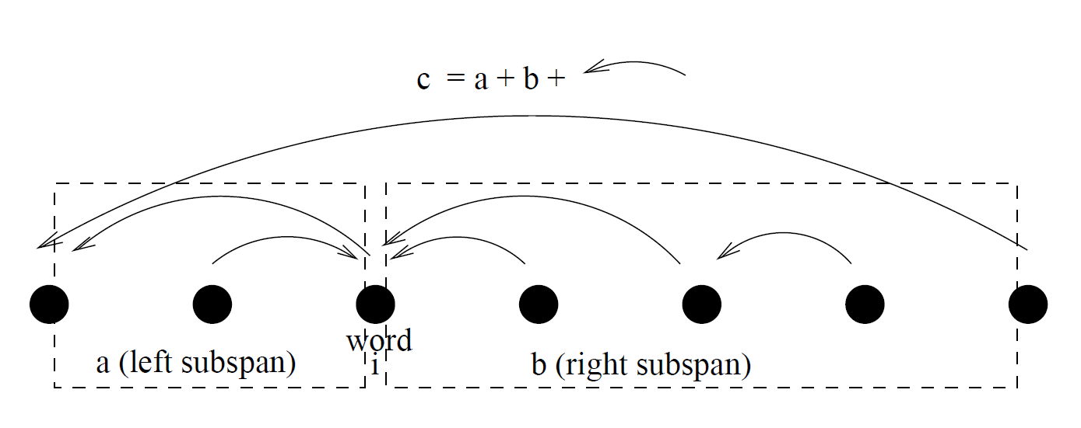
Eisner Dependency Parsing
Covered-concatenation
a must be minimal.
overlapping word must have a parent in exactly one of a and b.
c must not be given a covering link if either the leftmost word of a or the rightmost word of b has a parent.

Slide 16
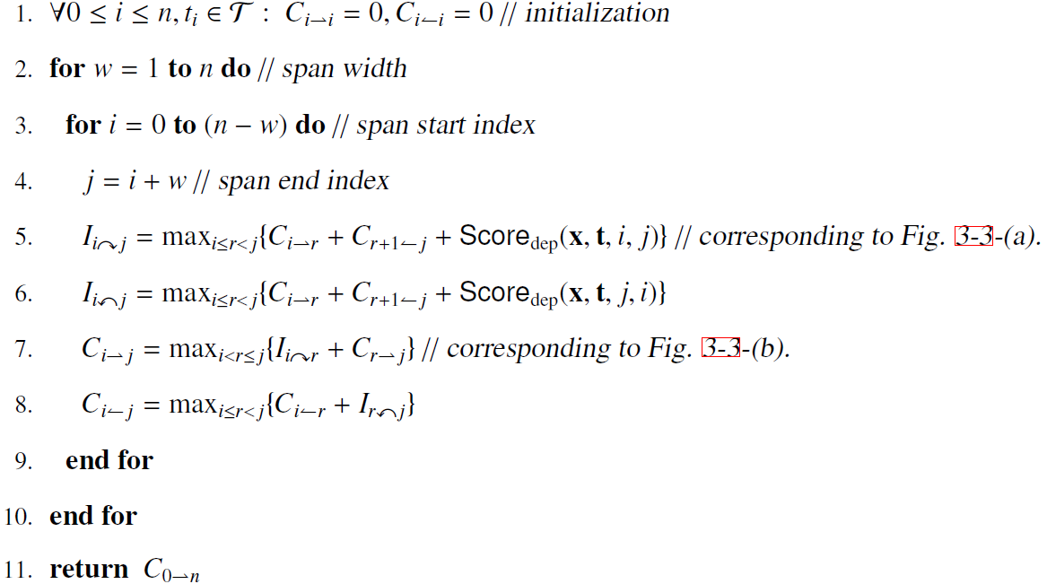
Eisner Dependency Parsing

Slide 17
Q & A

